Slide 1
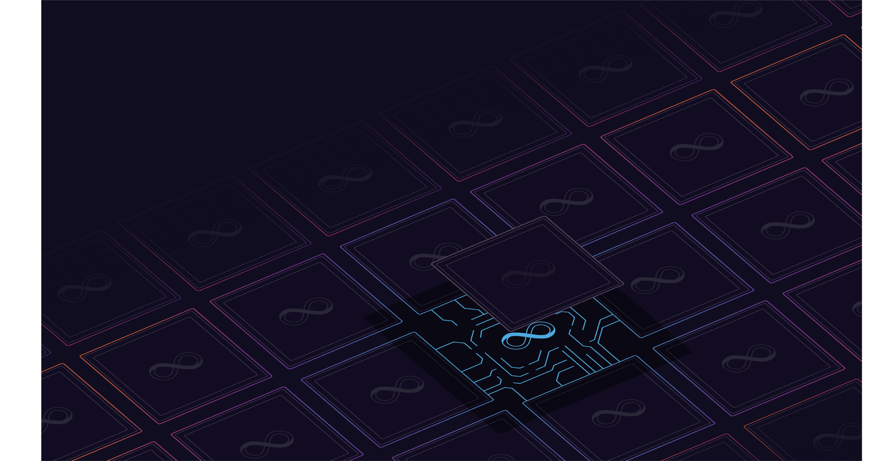

DFINITY Onboarding Deck
Implications of Routing Coherence and Consistency on Network Optimization
Yvonne-Anne Pignolet (DFINITY), Stefan Schmid (University of Vienna) , Gilles Tredan (LAAS-CNRS)
IFIP Networking 2020

Slide 2

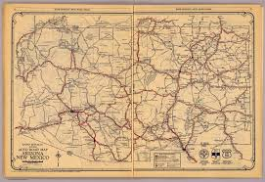
Invitation: A Road Trip in Networks
‹#›
Road map 1927: Arizona and New Mexico
Notes:
In this talk, we would like to invite you on a road trip. In particular, we will revisit routing strategies in networks, and their underlying models.

Slide 3


Routing and Traffic Engineering (TE)
‹#›
Evergreen topic in networking
Especially TE technologies evolved
Traditionally: weight-based shortest paths (e.g., OSPF, ECMP)
More recently: MPLS, SDN, Segment Routing
Introduces great opportunities for optimization
Typical goal: avoid congestion
Notes:
Routing and traffic engineering are an evergreen topic in networking.
In order to make best use of network infrastructures, it is often critical for network operators to use clever traffic engineering algorithms which, e.g., avoid congestion.
And in fact, many of the recent innovations in networking were motivated by the desire to make traffic engineering more flexible and improve routing.
Traditionally, traffic engineering flexibilities were rather limited, forcing operators to manually adjust weights to change shortest paths.
More recent technologies, related to MPLS, SDN and Segment Routing, facilitate a more direct control over the routes, and their benefits have been demonstrated in many use cases over the last years.

Slide 4
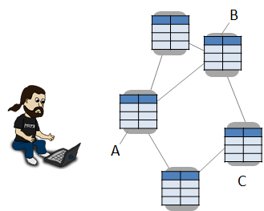

Network Policies: Constraints on Routes
‹#›
Routes typically need to fulfill certain policies
Loop-free?
E.g.: Loop-freedom: Are the routes loop-free?
Notes:
Let us look at some of the factors that influence routing and traffic engineering.
Often, routing algorithms need to adhere to some constraints, for example, we typically don’t want loops in our routes

Slide 5

Network Policies: Constraints on Routes
‹#›
Routes typically need to fulfill certain policies
Policy ok?
E.g.: Waypoints: Is it ensured that traffic from A to B is always routed via a node C (e.g., a firewall)?
Notes:
Or we must guarantee that all packets pass a firewall

Slide 6

Network Policies: Constraints on Routes
‹#›
Routes typically need to fulfill certain policies
Policy ok?
E.g.: Blacklists: Is it ensured that traffic from A to B never goes via C?
Notes:
Or a certain region must be avoided at all cost

Slide 7
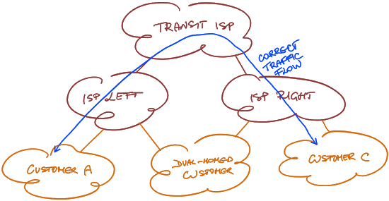

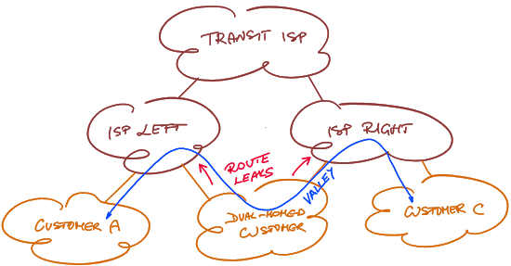
Many More
‹#›
E.g., valley-free, shortest paths routing, ...
Notes:
Not just topology influences these decisions, we may have attributes on nodes that must be considered for efficiency or regulations

Slide 8
Consistency Properties
‹#›
Shared characteristic of previous examples: properties of individual routes!
=> consistency properties
Often specified with regular expressions
e.g., (c2p)*(p2p)?(p2c)* for valley-free routing
Or routing algebras
e.g., (ℝ+,∞,+,=<) for shortest paths routing
Notes:
All these properties have in common: they are properties of individual routes!
We’ll call them consistency properties
There are different ways of expressing them and of making quantitative statements for them

Slide 9

But there is another dimension to routing...
‹#›
Notes:
In addition to coherence properties, another class of properties is often forgotten, that has an equally high impact on network optimization

Slide 10
Coherence Properties
‹#›
Some properties hold for a set of routes (not individual routes) => coherence properties
Examples
Symmetric: A -> B, B -> A
Confluent: same dst routes form a tree
Useful for load balancing, routing table space, CPU
Notes:
We call them coherence properties, they involve a whole set of routes, not a single route. E.g., depending on the routing protocol used, the produced routes maybe be symmetric, or form a tree for a given destination. These properties are particularly important for the efficient operation of networks.

Slide 11
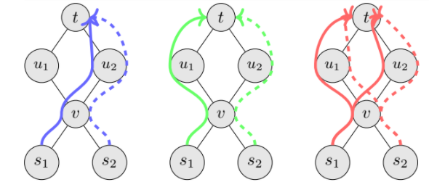
Coherence Illustration
Properties of sets of routes = “how routes relate to each other”
Impact:
Load Balancing: Is u_2 congested ?
Monitoring: Is u_1 up ?
Different answers depending on coherence...
> ! *
same dst routes form a tree
exactly one route per src-dst
all routes set are valid
Notes:
Let’s make this a bit more concrete. On the left,

Slide 12
Motivation for This Paper
‹#›
Consistency and coherence requirements influence:
available path diversity (search space)...
… and hence achievable objective function
… and hardness of underlying optimization problems
However:
Effects hardly understood today
Algorithm designers often just think about graphs
We need to account for the routing model influence !
Notes:
Vielen Dank!

Slide 13

Roadmap
How did we end up working on this?
Routing models
Impact on quality and complexity
Empirical findings
Notes:
I would like to tell you more, but I don’t have time :-)

Slide 14
Network Tomography
Goal: obtain detailed picture of network from E2E measurements
Is link (B,C) up?
=> Infer topology and link status
Optimization problem: deploy minimum equipment to monitor all edges

Slide 15
Network Tomography
Network graph input is not enough to solve this problem => Introduce routing models and investigate their impact
Goal: obtain detailed picture of network from E2E measurements
Is link (B,C) up?
=> Infer topology and link status
Optimization problem: deploy minimum equipment to monitor all edges

Slide 16
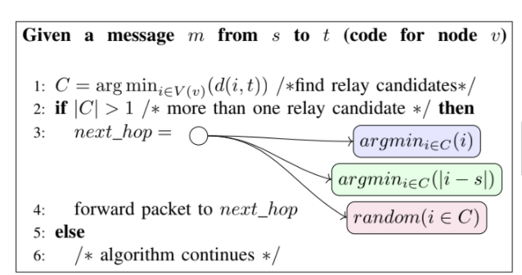
Routing Algorithms
Input G alone is ambiguous (even with shortest path consistency):
Select consistent routes
> ! *
same dst routes form a tree
exactly one route per src-dst
all routes set are valid
Notes:
Lowest next hop mac address
Source mac address
random

Slide 17
Routing Algorithms
Input G alone is ambiguous (even with shortest path consistency):
Coherence depends on tie-breaking decisions
> ! *
same dst routes form a tree
exactly one route per src-dst
all routes set are valid

Slide 18
Routing Algorithms
Input G alone is ambiguous (even with shortest path consistency):
> ! *
Tie-breaking is often overlooked in protocol design despite its impact
Notes:
Tie-breaking decision is crucial, but often we can’t influence it

Slide 19
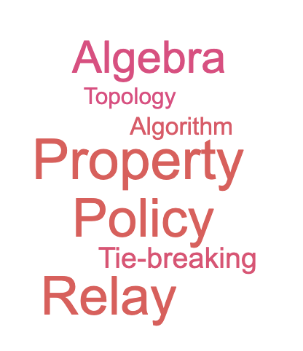
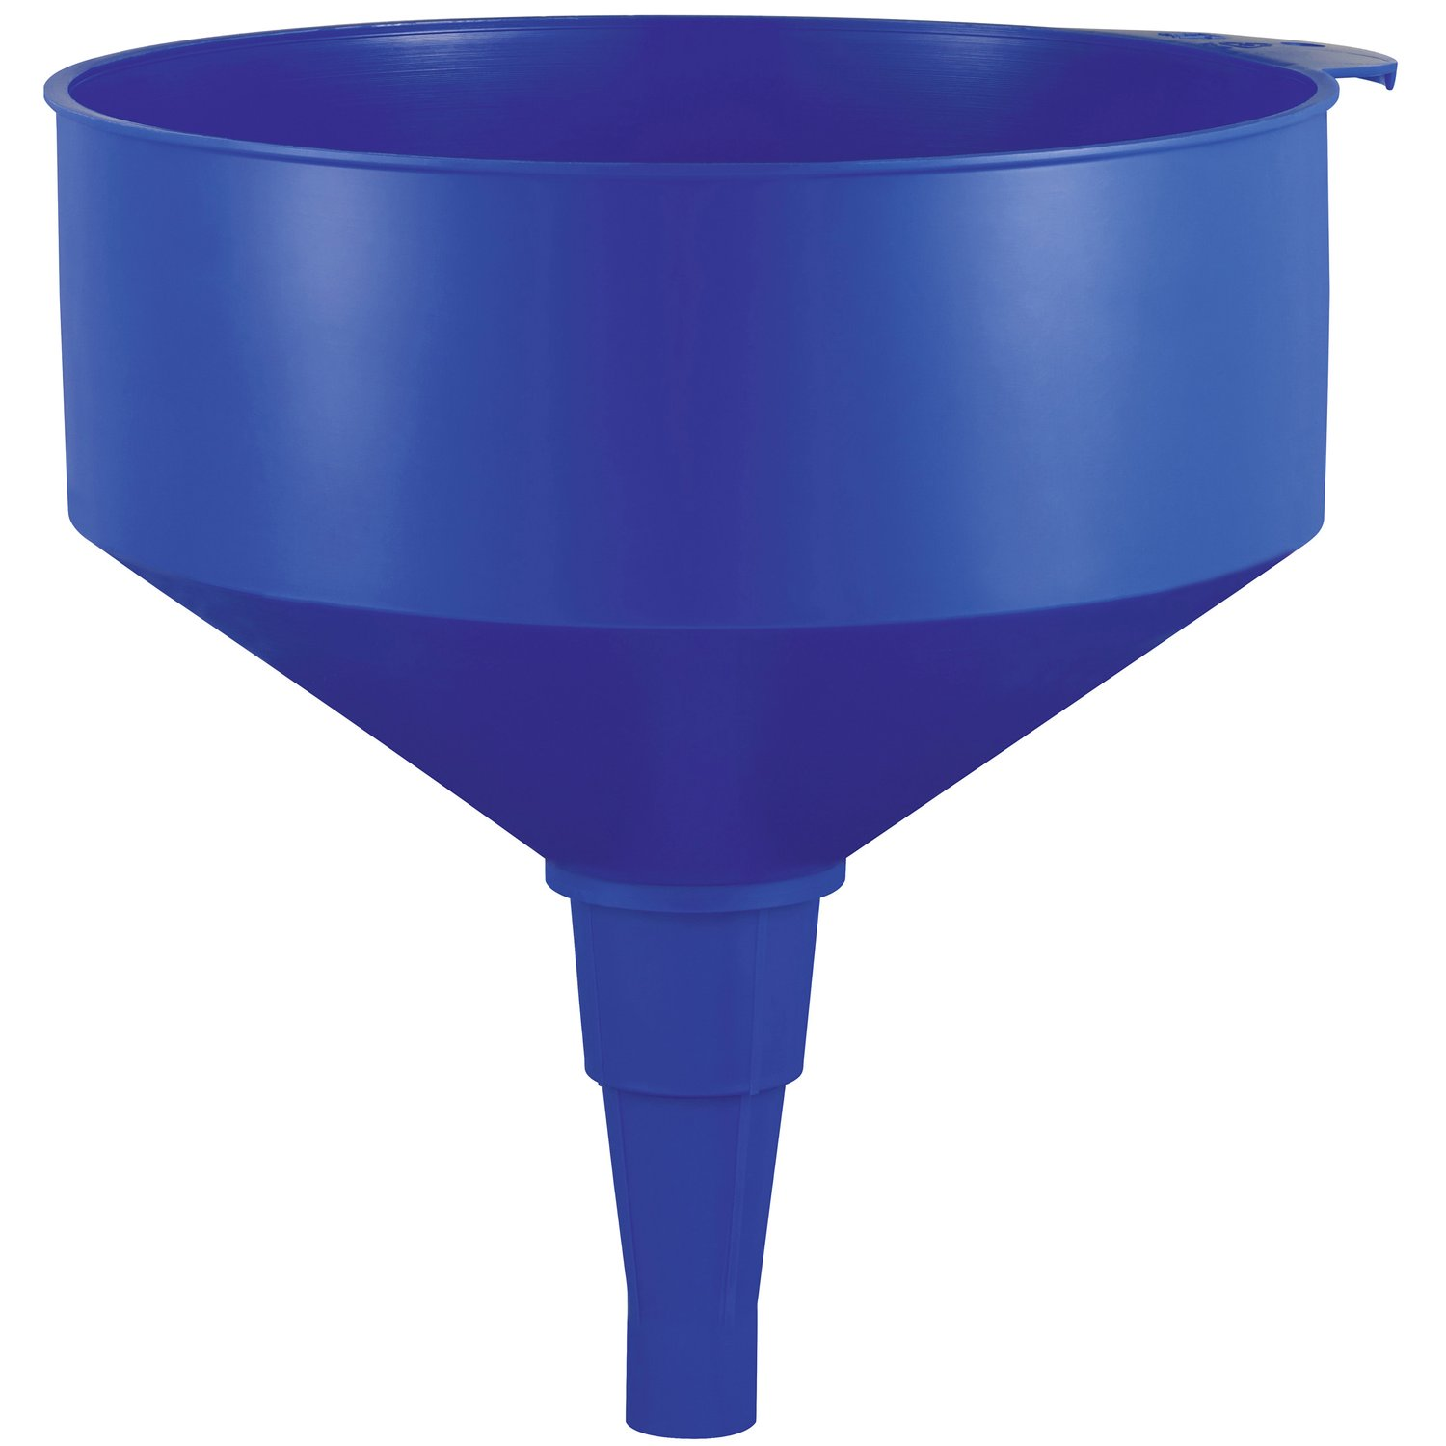
Routing Model
Notes:
Let’s now combine all this information in a way that allows us to explore network optimization problems without focussing on one concrete algorithm

Slide 20
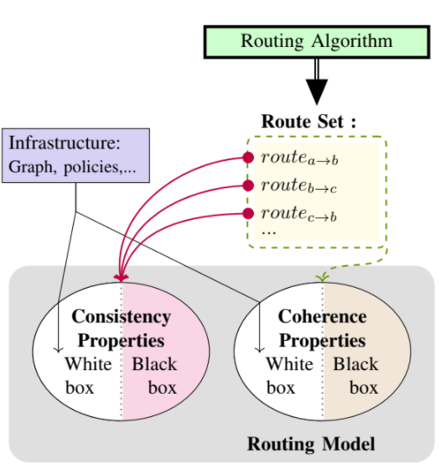
Routing Model
Notes:
Let’s summarize: A set of routes produced by a routing algorithm can have several types of properties

Slide 21
Routing Model
Consistency: per route
Shortest path
Way points
Valley-freedom
….
Notes:
On the one hand consistency properties but also coherence properties

Slide 22
Routing Model
Coherence: per route set
Canonical properties of route sets
Structure the space from most constrained model to most permissive model
e.g., <, !, *
Consistency: per route
Shortest path
Way points
Valley-freedom
….
Notes:
we explored coherence space by studying canonical properties routes sets typically have,
allowing us to structure the space from the most constrained mode - to the least constrained model
Show how this structure shapes the complexity landscape of some TE problems and tomography

Slide 23
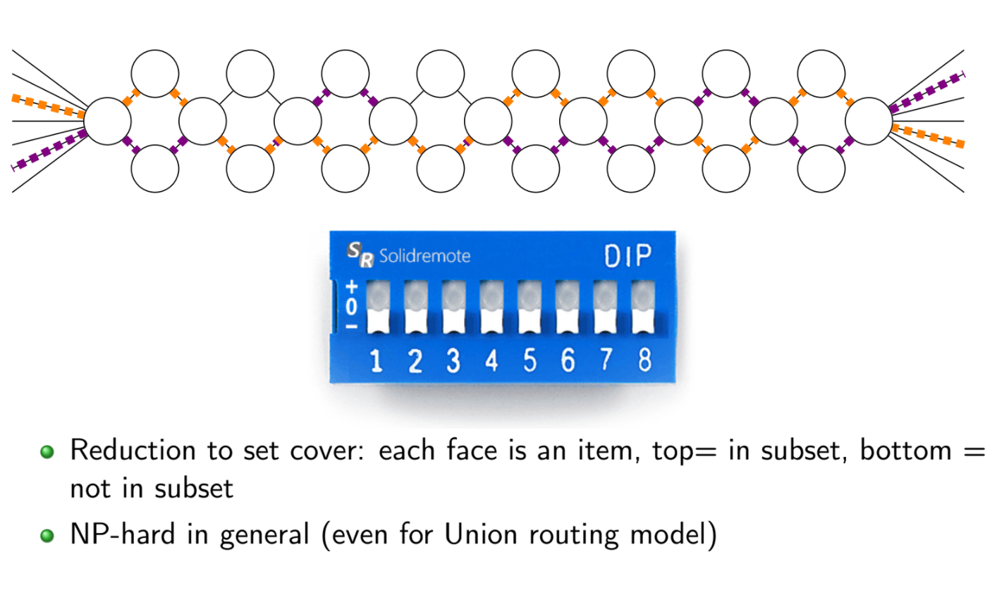
Impact on Complexity and Quality
Examples
Coherence
Tomography:
!, > : NP-hard in general
!: NP-hard on cactus graphs, possibly O(1) deployment >: polynomial on cactus graphs and O(n) deployment
Notes:
Here we present a subset of the results we discuss in our paper
For coherence, we can prove that the tomography optimization problem introduced earlier is NP in many models
For example, !, >
If we restrict the network topologies to certain graph classes, it is possible to monitor them with a constant size monitoring deployment, but hard to find it, e.g., in a graph like the one you see here
While in more constrained models, e.g., the confluent model the size of the deployment is linear, yet we can compute it efficiently,

Slide 24
Impact on Complexity and Quality
Examples
Coherence
Tomography:
!, > : NP-hard in general
!: NP-hard on cactus graphs, possibly O(1) deployment >: polynomial on cactus graphs and O(n) deployment
Consistency
Traffic engineering:
shortest capacity-respecting paths in O(poly(n))
NP-hard if path must pass a given waypoint
congestion with sp up to Ω(n^2) larger than achievable
Notes:
If we look at Consistency and traffic engineering we observe similar difference
E.g., with Dijkstra we can compute shortest paths with capacity bounds in polynomial time
However, it becomes NP hard if a certain waypoint must be traversed
Or, regarding the quality, congestion with shortest paths maybe a large factor worse than best possible

Slide 25
Impact on Complexity and Quality
Examples
Coherence
Tomography:
!, >: NP-hard in general
!: NP-hard on cactus graphs, possibly O(1) equipment >: polynomial on cactus graphs and O(n) equipment
Trade-off between search space size and quality
Consistency
Traffic engineering:
shortest capacity-respecting s-t-path in O(poly(n)),
NP-hard if path must pass a given waypoint
congestion with sp up to Ω(n^ 2 ) larger than achievable
Notes:
In both cases, there is a tradeoff, to be used to our advantage when studying optimization problems

Slide 26
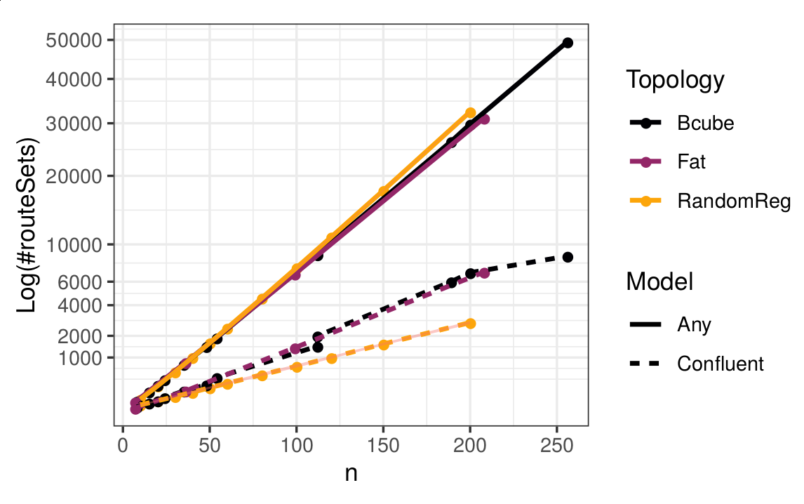
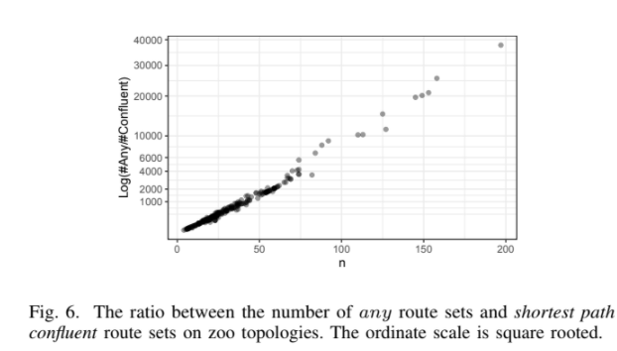
Empirical Analysis
Research question: How big is the search space in practice?
LAN/ datacenter topologies (synthetic)
WAN/ topology zoo topologies (real)
Log( ! / >)
!
>
Notes:
In case you wonder if these problems only manifest in contrived theoretical examples, we investigates both typical LAN and WAN topologies.
More precisely, we computed the number of different route sets for the confluent and exactly one coherence model with shortest path consistency.
As you can see in these plots, both the absolute numbers as well as their ratio grow quickly when increasing the number of nodes.

Slide 27
Takeaways
Coherence relation between routes is often overlooked Tie breaking is crucial => Routing model
Not only consistency, but also coherence impact
Quality
Complexity
Related work: Erlebach09, Chekuri07, Pignolet18
=> exploit it!
yvonneanne@dfinity.org stefan_schmid@univie.ac.at
gtredan@laas.fr
Notes:
To sum up what we’ve seen in this talk, we’ve studied properties of single routes as well as route sets and how shown that both of them can have a huge influence on the quality and complexity of network optimization problems, so let’s make us of that whenever we can
Thanks a lot for your attention and of course we welcome any questions, live or via email later.

Slide 28
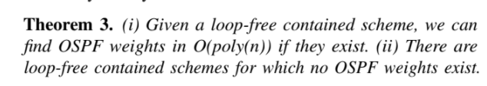
OSPF

Slide 29
Routing Models
Consistency: per route
Shortest path
Way points
Valley-freedom
….
Described with regular languages or algebraic methods
Coherence: per route set
Multi: any subset is valid
Any: exactly one route per src-dst
Confluent: same dst routes form a tree
Contained: two routes share at most one subroute
Forest: union of all routes is a forest
Symmetric: same route in both directions
=> load balancing, routing table space, CPU

Slide 30
Routing Models
White box vs black box

Slide 31
Network Policies: Constraints on Routes
Routes typically need to fulfill certain policies
Reachable?
E.g.: Reachability: Can traffic from A reach B?
Notes:
Vielen Dank!

Slide 32
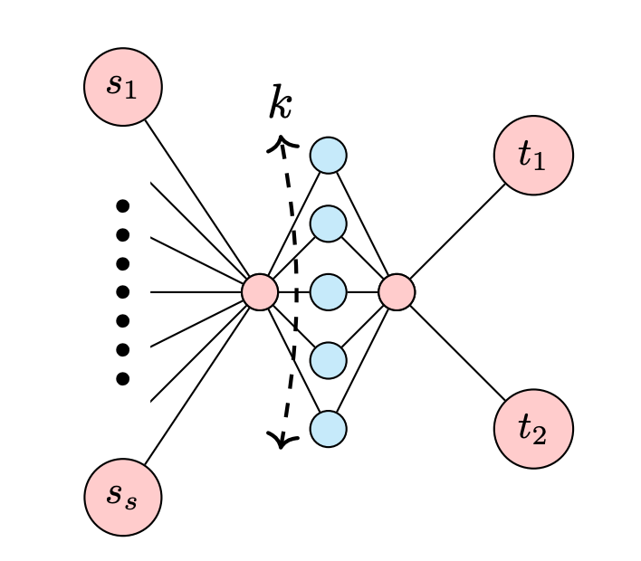
Routing Model Impacts Quality
Examples
Coherence impacts quality:
Tomography:
!: O(√ k) monitoring equipment
> , ⊆: Omega(k) equipment
Traffic Engineering:
> congestion up to Ω(|V|) higher than for !
Consistency impacts quality:
Traffic engineering: congestion with shortest path routing up to Ω(n^ 2 ) larger than achievable

